Slide 1
专病组web and posters
Sequence of arrangement: Based on year of establishment
Based on Healthcare Services Act (HCSA) for Traditional Chinese Medicine Practitioners (TCMPs), ads purport to treat medical conditions or diseases are currently already prohibited. Eg. “we are experienced in treating scoliosis”, “we treat chronic diseases such as diabetes” or “we have experience in treating female hormonal and fertility problems”. 这包括了医疗广告内声称所提供的医疗服务能治疗身体的病痛、 疾病、 外伤、 或症状等。 例如“我们在治疗脊柱侧弯方面经验丰富” ，“我们治疗糖尿病等慢性疾病” 或“我们有治疗女性荷尔蒙失调和生育问题方面的经验” 。
 | 专病组 | 成立
1 | 中医心血管病专病组 | 1989
2 | 中医肿瘤专病组 | 1993
3 | 中医生育专病组 | 1993
4 | 中医中风后遗症专病组 | 1997
5 | 中医肠胃病专病组 | 1998
6 | 中医糖尿病专病组 | 2003
7 | 中医眼科专病组 | 2010
8 | 中医针灸刮痧专病组 | 2010
9 | 中医筋伤痛症专病组 | 2012
10 | 中医盆底疾病专病组 | 2019
11 | 中医老年疾病专病组 | 2022
12 | 中医治未病专病组 | 2023

Slide 2
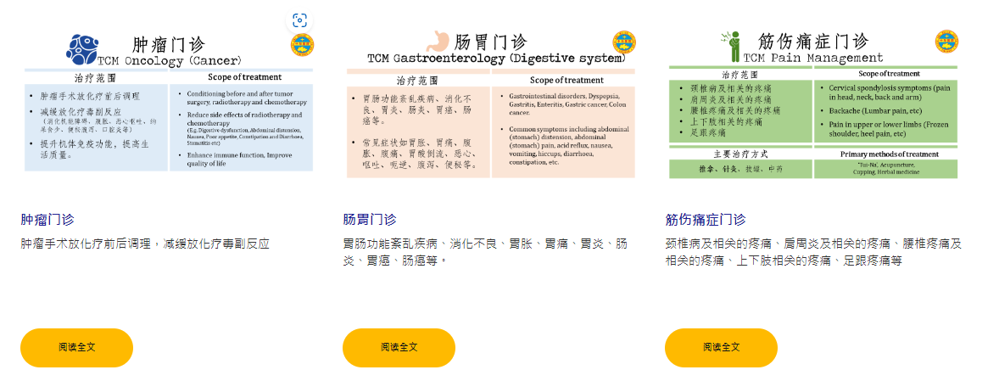
Webpage sample

Slide 3
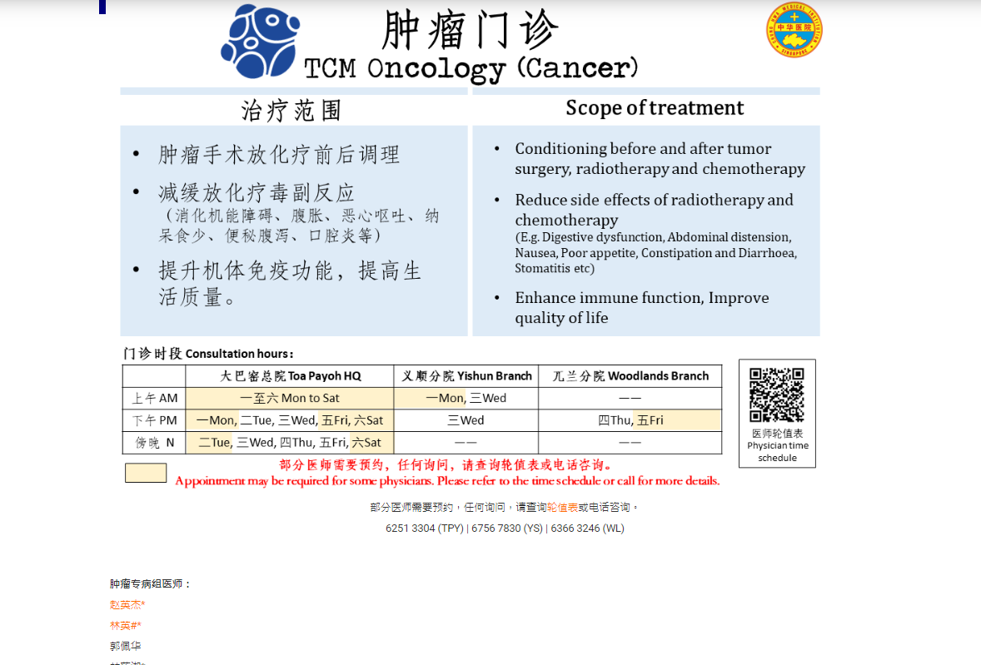
Webpage sample

Slide 4




中医心血管病门诊
TCM Cardiology Clinic
疾病管理范围 |  | Scope of Management
心血管疾病(心悸怔忡、胸痹心痛/心绞痛、冠心病/动脉粥样硬化、心律失常、心瓣膜疾病、心力衰竭、肺心病、风湿性心脏病、先天性心脏病、血脂异常、高血压、周围血管疾病等) 心系疾病(头晕、失眠等) |  | Cardiovascular diseases (Heart palpitation, Angina pectoris, Coronary heart disease/atherosclerosis, Arrhythmia, Valvular heart disease, Heart failure, Pulmonary heart disease, Rheumatic heart disease, Congenital heart disease, Dyslipidemia, Hypertension, Peripheral vascular disease, etc) “Heart” related diseases (Vertigo, Insomnia, etc)
门诊时段 Consultation hours
 | 大巴窑 Toa Payoh | 兀兰 Woodlands
上午 AM | —— | ——
下午 PM | 二Tue | ——
傍晚 N | 三Wed, 四Thu* | 五Fri
医师轮值表
Physician time schedule
线上预约
E-Appointment
*部分医师需要预约，任何询问，请查询轮值表或电话咨询。
Appointment may be required for some physicians. Please refer to the time schedule or call for more details.

Slide 5

中医肿瘤门诊
TCM Oncology Clinic
疾病管理范围 |  | Scope of Management
肿瘤手术放化疗前后调理 减缓放化疗毒副反应 （消化机能障碍、腹胀、恶心呕吐、纳呆食少、便秘腹泻、口腔炎等） 提升机体免疫功能，提高生活质量。 |  | Conditioning before and after tumor surgery, radiotherapy and chemotherapy Reduce side effects of radiotherapy and chemotherapy (E.g., Digestive dysfunction, Abdominal distension, Nausea, Poor appetite, Constipation and Diarrhoea, Stomatitis etc) Enhance immune function, Improve quality of life
门诊时段 Consultation hours
 | 大巴窑 Toa Payoh | 诺维娜 VIVA | 义顺 Yishun | 兀兰 Woodlands
上午 AM | 一至六 Mon to Sat* | 一 Mon*, 二Tue*, 四Thu*, 五Fri* | 一Mon*, 三Wed | ——
下午 PM | 一Mon*, 二Tue*，三Wed, 五Fri, 六Sat* | 一至五 Mon to Fri* | 三Wed | 四Thu
傍晚 N | 二Tue, 五Fri*, 六Sat* | —— | —— | ——
医师轮值表
Physician time schedule
线上预约
E-Appointment
*部分医师需要预约，任何询问，请查询轮值表或电话咨询。
Appointment may be required for some physicians. Please refer to the time schedule or call for more details.

Slide 6

中医生育门诊
TCM Fertility Clinic
疾病管理范围 |  | Scope of Management
辅助IVF & IUI，提高成功率 男性：阳痿，早泄，不射精，精液异常 女性：月经不调，多发性流产，多囊卵巢综合征，卵巢早衰，子宫内膜异位，输卵管阻塞，功能失调性子宫出血，子宫腺肌症 |  | Improve the success rate of IVF & IUI Male: Erectile Dysfunction, premature ejaculation, sperm abnormalities, Anejaculation Female: Blocked Fallopian Tubes, Recurrent miscarriage, Polycystic ovary syndrome (PCOS), Endometriosis, Anovulation, Irregular menstruation, Premature ovarian insufficiency/failure, Dysfunctional uterine bleeding, Adenomyosis
门诊时段 Consultation hours
 | 大巴窑 Toa Payoh
上午 AM | ——
下午 PM | ——
傍晚 N | 二Tue*, 三Wed*, 四Thu* , 六Sat*
医师轮值表
Physician time schedule
线上预约
E-Appointment
*部分医师需要预约，任何询问，请查询轮值表或电话咨询。
Appointment may be required for some physicians. Please refer to the time schedule or call for more details.
Notes:
Added wed n fri time slot （XJH）
Removed wed night slot

Slide 7

中医中风后遗症门诊
TCM Post-Stroke Management Clinic
疾病管理范围 |  | Scope of Management
中风后遗症如： 半身肢体不遂（手足麻木、手指震颤） 口眼喎斜、口角流涎 其他神志、运动、感觉以及语言障碍等。 |  | Apoplectic sequela including: Body paralysis (Numbness, hand tremors, etc) Facial paralysis (Drooling, Ptosis, etc) Other psychological, physiological, linguistic disorder
门诊时段 Consultation hours
 | 大巴窑 Toa Payoh | 义顺 Yishun | 如切 Joo Chiat
上午 AM | 一Mon*, 二Tue*, 三Wed*, 四Thu*, 六Sat* | 六Sat | 五Fri*
下午 PM | 一至四 Mon to Thu* | —— | 五Fri*
傍晚 N | 二Tue*, 四Thu | —— | ——
医师轮值表
Physician time schedule
线上预约
E-Appointment
*部分医师需要预约，任何询问，请查询轮值表或电话咨询。
Appointment may be required for some physicians. Please refer to the time schedule or call for more details.
Notes:
No change

Slide 8

中医肠胃病门诊
TCM Gastroenterology Clinic
疾病管理范围 |  | Scope of Management
胃肠功能紊乱疾病、消化不良、胃炎、肠炎、胃癌、肠癌等。 常见症状如胃胀、胃痛、腹胀、腹痛、胃酸倒流、恶心、呕吐、呃逆、腹泻、便秘等。 |  | Gastrointestinal disorders, Dyspepsia, Gastritis, Enteritis, Gastric cancer, Colon cancer. Common symptoms including abdominal (stomach) distension, abdominal (stomach) pain, acid reflux, nausea, vomiting, hiccups, diarrhoea, constipation, etc.
门诊时段 Consultation hours
 | 大巴窑 Toa Payoh | 诺维娜 VIVA
上午 AM | 一Mon, 二Tue, 四Thu, 六Sat | ——
下午 PM | —— | 三Wed*, 四Thu*
傍晚 N | 二Tue*, 三Wed, 五Fri | ——
医师轮值表
Physician time schedule
线上预约
E-Appointment
*部分医师需要预约，任何询问，请查询轮值表或电话咨询。
Appointment may be required for some physicians. Please refer to the time schedule or call for more details.
Notes:
No change

Slide 9

中医眼科门诊
TCM Ophthalmology Clinic
疾病管理范围 |  | Scope of Management
结合最先进的临床眼科仪器检查并调理干眼、巩膜炎、葡萄膜炎、麻痹性眼肌病变 、黄斑病变、视网膜病变、青光眼、自身免疫系统眼科疾病、遗传性眼科疾病、视神经疾病等。 |  | Utilizes advanced clinical ophthalmic instruments in the management of Dry eye, Scleritis, Uveitis, Ocular lesions, Macular Degeneration, Glaucoma, Retinopathy, Autoimmune eye disease, Hereditary eye disease, Optic nerve disease
门诊时段 Consultation hours
 | 大巴窑 Toa Payoh
上午 AM | 二Tue*, 六Sat*
下午 PM | ——
傍晚 N | 一Mon*
医师轮值表
Physician time schedule
线上预约
E-Appointment
*部分医师需要预约，任何询问，请查询轮值表或电话咨询。
Appointment may be required for some physicians. Please refer to the time schedule or call for more details.
Notes:
No change

Slide 10
中医儿童眼科门诊
TCM Paediatric Ophthalmology Clinic
疾病管理范围 |  | Scope of Management
防控儿童近视包括预防近视恶化 |  | Control and prevention of myopia in children, including prevention of myopia aggravation
主要方式 |  | Primary methods
眼部针灸、眼部按摩、眼部艾灸和视光检测 |  | Eye acupuncture, Eye massage, Eye moxibustion, Optical test
门诊时段 Consultation hours
 | 义顺 Yishun
上午 AM | 六Sat* 每月第一、第三周 Every 1st, 3rd week of the month
医师轮值表
Physician time schedule
线上预约
E-Appointment
*部分医师需要预约，任何询问，请查询轮值表或电话咨询。
Appointment may be required for some physicians. Please refer to the time schedule or call for more details.
Notes:
No change

Slide 11


中医针灸刮痧门诊
TCM Acupuncture and Scraping Clinic
疾病管理范围 |  | Scope of Management
颈椎病、肩周炎、落枕、慢性腰痛、筋伤、风湿性关节炎等 |  | Cervical spondylosis, Frozen Shoulder, Stiff neck, Chronic back pain, Muscle injury, Rheumatoid arthritis, etc
主要方式 |  | Primary methods
刮痧、针灸、拔罐、中药 |  | Scraping, Acupuncture, Cupping, Herbal medicine
门诊时段 Consultation hours
 | 大巴窑 Toa Payoh
上午 AM | ——
下午 PM | 六Sat
傍晚 N | 三Wed
医师轮值表
Physician time schedule
线上预约
E-Appointment
*部分医师需要预约，任何询问，请查询轮值表或电话咨询。
Appointment may be required for some physicians. Please refer to the time schedule or call for more details.
Notes:
No change

Slide 12

中医筋伤痛症门诊
TCM Pain Management Clinic
疾病管理范围 |  | Scope of Management
颈椎病及相关的疼痛 腰椎疼痛及相关的疼痛 上下肢（肩周炎、足跟疼痛等相关的疼痛 |  | Cervical spondylosis symptoms (pain in head, neck, back and arm) Backache (Lumbar pain, etc.) Pain in upper or lower limbs (Frozen shoulder, heel pain, etc.)
主要方式 |  | Primary methods
推拿、针灸、拔罐、中药 |  | ‘Tui-Na’, Acupuncture, Cupping, Herbal medicine
门诊时段 Consultation hours
 | 大巴窑 Toa Payoh | 义顺 Yishun | 兀兰 Woodlands | 武吉班让 Bukit Panjang | 如切 Joo Chiat
上午 AM | —— | 三Wed | —— | —— | ——
下午 PM | —— | —— | —— | —— | ——
傍晚 N | 一Mon*, 五Fri* | 一Mon, 二Tue*, 三Wed*, 四Thu* | 二Tue, 四Thu* | 四Thu | 一至五 Mon to Fri*
医师轮值表
Physician time schedule
线上预约
E-Appointment
*部分医师需要预约，任何询问，请查询轮值表或电话咨询。
Appointment may be required for some physicians. Please refer to the time schedule or call for more details.
Notes:
No change

Slide 13

中医盆底疾病门诊
TCM Pelvic Floor Disorders Clinic
疾病管理范围 |  | Scope of Management
尿失禁、尿潴留、排尿异常； 便秘，大便失禁、肛门直肠痛、直肠脱垂、痔、肛瘘、肛裂； 女性子宫脱垂、阴道脱垂； 男性良性前列腺增生等 |  | Urinary incontinence, urinary retention, abnormal urination; Constipation, fecal incontinence, Anorectal pain, rectal prolapse, haemorrhoids, anal fistula, anal fissure; Female uterine prolapse, vaginal prolapse； Male benign prostatic hyperplasia, etc.
门诊时段 Consultation hours
 | 大巴窑 Toa Payoh
上午 AM | 一Mon, 三Wed*, 四Thu, 六Sat
下午 PM | ——
傍晚 N | 一Mon, 二Tue,三Wed, 四Thu
医师轮值表
Physician time schedule
线上预约
E-Appointment
*部分医师需要预约，任何询问，请查询轮值表或电话咨询。
Appointment may be required for some physicians. Please refer to the time schedule or call for more details.
Notes:
No change

Slide 14

中医老年疾病门诊
TCM Geriatric Clinic
疾病管理范围 |  | Scope of Management
以中老年期（55岁以上）的患者为主。根据患者个人具体健康情况而拟定个体化疾病管理方案，以改善生活品质。 疾病管理范围：老年性痴呆、帕金森氏病、失眠、耳鸣、老年性皮肤瘙痒、退行性骨关节病（如膝关节炎、肩周炎等） |  | Focus mainly on patients above the age of 55. To provide holistic management for common geriatric related health conditions and improve the quality of life. Scope of management: Alzheimer's Disease, Parkinson's Disease, Insomnia, Tinnitus, Pruritus, Osteoarthritis, etc.
门诊时段 Consultation hours
 | 大巴窑 Toa Payoh | 诺维娜 VIVA | 兀兰 Woodlands | 如切Joo Chiat
上午 AM | 一Mon, 三Wed, 四Thu, 五Fri, 六Sat* | 五Fri* | 一Mon, 二Tue, 三Wed, 五Fri | 一至六 Mon to Sat*
下午 PM | 一Mon, 三Wed*, 四Thu, 五Fri | —— | 一Mon, 二Tue, 三Wed, 五Fri, 六Sat | 一至六 Mon to Sat*
医师轮值表
Physician time schedule
线上预约
E-Appointment
*部分医师需要预约，任何询问，请查询轮值表或电话咨询。
Appointment may be required for some physicians. Please refer to the time schedule or call for more details.
Notes:
To remove
TPY - tues pm
JC- mon,thu,fri (am,pm), wed (am),
To add:
JC - Sat pm

Slide 15

中医治未病门诊
TCM Preventive Medicine Clinic
疾病管理范围 |  | Scope of Management
推广“治未病”(未病先防、既病防变、瘥后防复)思想，采取相应措施，维护健康，防止疾病的发生与发展。 体质调理包括亚健康疾病：睡眠障碍、潮热、疲劳、压力、冠病后遗症等 防控慢性疾病：糖尿病和糖尿病前期，三高症（高血压+高血脂+高血糖），免疫力低下等 |  | Promote the concept of “Preventive Medicine” (Prevent disease occurrence, progression and recurrence). Adopt appropriate measures to maintain health and prevent disease occurrence and progression. Body constitution conditioning include sub-health diseases such as sleep disorders, hot flushes, fatigue, stress, post-Covid syndrome and etc Prevention and control chronic diseases such as Diabetes, Pre-diabetes, High blood pressure, High cholesterol, low immunity and etc
门诊时段 Consultation hours
 | 大巴窑 Toa Payoh | 义顺 Yishun | 兀兰 Woodlands | 武吉班让 Bukit Panjang
上午 AM | 六Sat | —— | —— | ——
下午 PM | 五Fri, 六Sat | 六Sat | —— | ——
傍晚 N | —— | 三Wed，四Thu | 四Thu | 四Thu
医师轮值表
Physician time schedule
线上预约
E-Appointment
*部分医师需要预约，任何询问，请查询轮值表或电话咨询。
Appointment may be required for some physicians. Please refer to the time schedule or call for more details.
Notes:
Added TPY fri pm
Removed TPY fri am
Removed yishun mon night， added Thu night (WZH)

Slide 16

中医耳鼻喉门诊
TCM Ear Nose Throat Clinic
疾病管理范围 |  | Scope of Management
耳：耳鸣、耳部感染、中耳炎等 鼻：鼻塞、鼻炎、过敏性鼻炎、鼻干症、鼻息肉、鼻衄等 喉：急慢性咽炎、咽喉杂病等 |  | Ear: Tinnitus, ear infections, otitis media, etc Nose: Nasal congestion, rhinitis, allergic rhinitis, dry nose, nasal polyps, epistaxis, etc Throat: Pharyngitis, etc
门诊时段 Consultation hours
 | 义顺 Yishun | 兀兰 Woodlands
上午 AM | 四Thu，五Fri | 六Sat*
下午 PM | 四Thu，五Fri | ——
傍晚 N | —— | ——
医师轮值表
Physician time schedule
线上预约
E-Appointment
*部分医师需要预约，任何询问，请查询轮值表或电话咨询。
Appointment may be required for some physicians. Please refer to the time schedule or call for more details.

Slide 17

中医肥胖门诊
TCM Weight Management Clinic
疾病管理范围 |  | Scope of Management
体重增加、活动不便、气喘吁吁、肌肉疲乏、关节疼痛、水肿、嗜睡、眩晕、焦虑、抑郁等 |  | Weight gain, limitation of mobility, Breathlessness, Muscle fatigue, Joint pain, Edema, Lethargy, Dizziness, Anxiety and Depression.
门诊时段 Consultation hours
 | 大巴窑 Toa Payoh
上午 AM | 一Mon*, 三Wed*, 六Sat*
下午 PM | 一Mon*, 三Wed*, 六Sat*
傍晚 N | ——
医师轮值表
Physician time schedule
线上预约
E-Appointment
*部分医师需要预约，任何询问，请查询轮值表或电话咨询。
Appointment may be required for some physicians. Please refer to the time schedule or call for more details.
Notes:
No change

Slide 18

中医头发护理门诊
TCM Hair Care Clinic
疾病管理范围 |  | Scope of Management
脱发、斑秃、秃顶、脂溢性脱发、疾病性脱发、营养性脱发等 |  | Alopecia, Alopecia Areata, Balding, Seborrheic Dermatitis, Disease-related hair loss, Hair loss due to Nutritional Deficiency
门诊时段 Consultation hours
 | 义顺 Yishun | 武吉班让 Bukit Panjang
上午 AM | 一Mon, 二Tue*, 四Thu,五Fri | ——
下午 PM | 一Mon*, 三Wed, 四Thu, 五Fri*, 六Sat | 二Tue*, 四Thu*
傍晚 N | 三Wed, 六Sat | ——
医师轮值表
Physician time schedule
线上预约
E-Appointment
*部分医师需要预约，任何询问，请查询轮值表或电话咨询。
Appointment may be required for some physicians. Please refer to the time schedule or call for more details.

Slide 19

中医儿科门诊
TCM Paediatric Clinic
疾病管理范围 |  | Scope of Management
年龄：0-18岁 感冒、咳嗽、肺炎喘嗽、哮喘、反复呼吸道感染、口疮、鹅口疮、呕吐、腹痛、胃脘痛、泄泻、便秘、厌食、积滞、 疳证、夜啼、汗证、注意力缺陷多功能障碍、多发性抽动症、惊风、癫痫、尿频、遗尿、五迟五软、各类皮肤病等。 |  | Suitable age: 0-18 years old Flu, cough, pneumonia, asthma, repeated respiratory tract infections, aphtha (mouth ulcers), candidiasis, vomiting, abdominal pains, diarrhoea, constipation, childhood anorexia (lack of appetite), dyspepsia (indigestion) and bloating, night terrors, sweating issues, attention deficit hyperactivity disorder (ADHD), Tourette’s syndrome, convulsions, epilepsy, frequent urination, enuresis (bed-wetting), developmental disorders, skin disorders, etc.
门诊时段 Consultation hours
 | 大巴窑 Toa Payoh | 诺维娜 VIVA | 兀兰 Woodlands
上午 AM | 三Wed | —— | ——
下午 PM | 一Mon | 小儿推拿：五Fri* | ——
傍晚 N | 小儿推拿：一Mon, 二Tue |  | 三Wed*
医师轮值表
Physician time schedule
线上预约
E-Appointment
*部分医师需要预约，任何询问，请查询轮值表或电话咨询。
Appointment may be required for some physicians. Please refer to the time schedule or call for more details.
Notes:
TP: Wed AM refer to 吴佳盛， Mon PM refer to 董菁菁
WL: Wed N refer to Chairman

