Slide 2
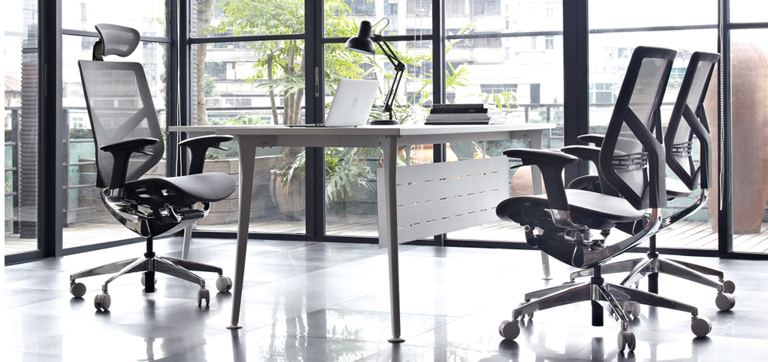
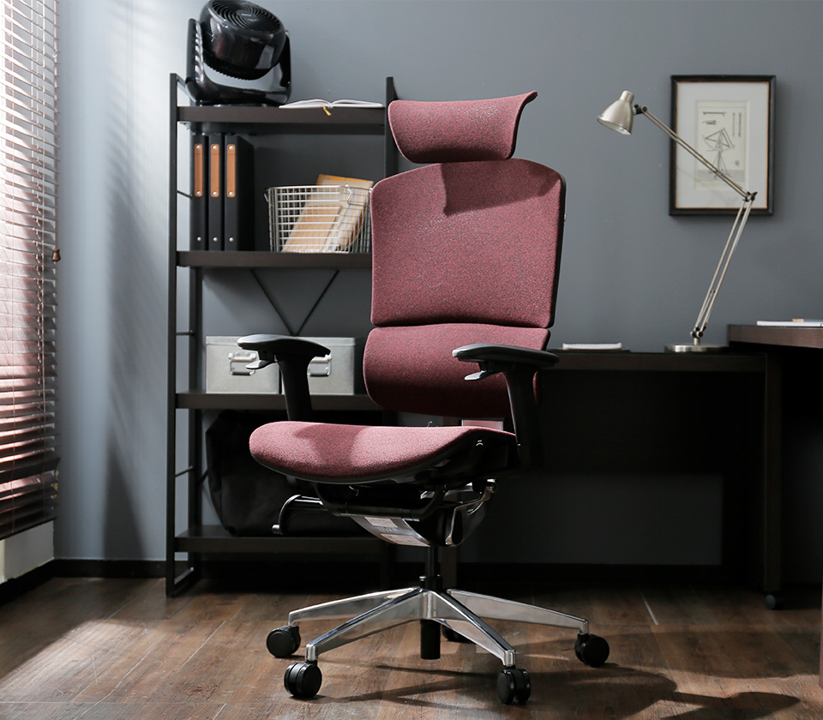
Main page for webpage

Slide 3
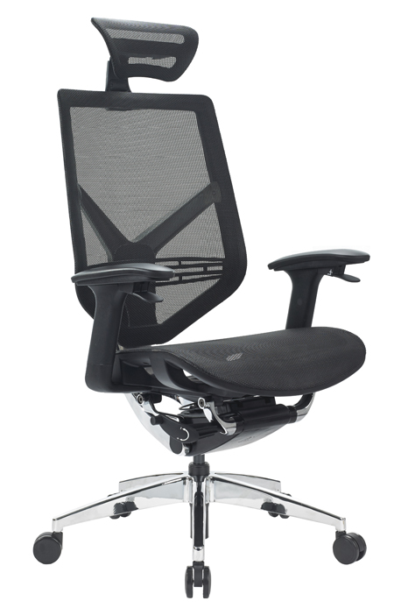
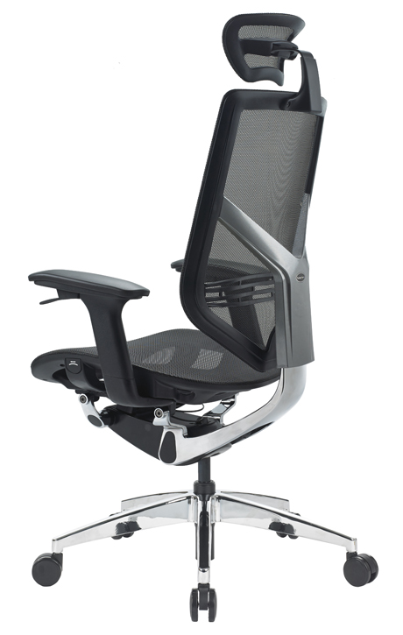
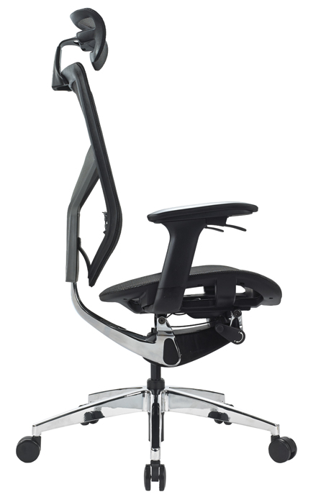
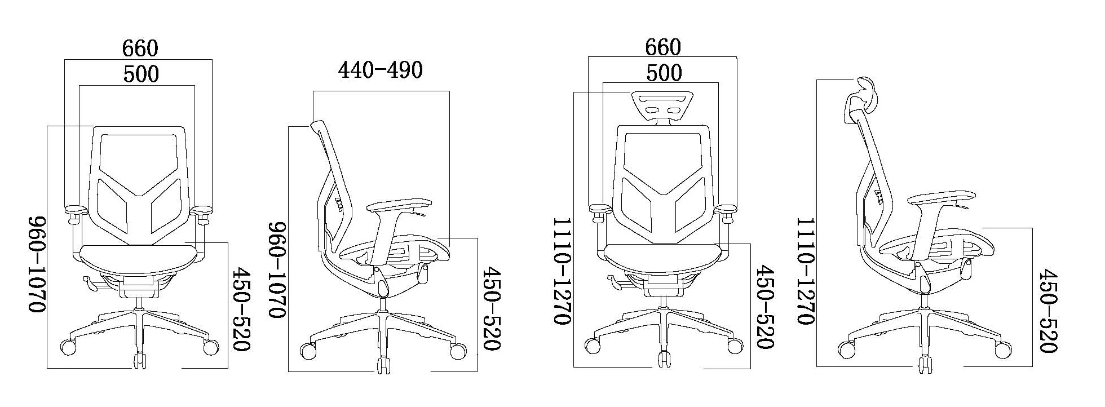
SEATING – Office Chairs - SR 15 ( Tender Form )

Slide 4
Office Chairs - SR 15 ( Tender Form ) Products details
1. Seat Height Adjust
The seat height can be adjusted by the paddle shift under
the right side armrest .Holding the paddle shift, the body
weight will make the chair lower , releasing the paddle shift ,
the chair height will be locked at desired position. Holding the
paddle shift without weight on the seat will make it rise .
Seat Depth Adjustment
Pressing the button on the left side of the seat will activate the
seat depth adjustment . Sliding chair seat with body strength ,
release the button at proper position will lock the seat .
2. Backrest Tilt Adjustment
The paddle shift under the left armrest can adjust the back tilting .
lifting the paddle shift once and release with the body weight pressure
on the back will lock the backrest at a proper position . Lifting the
paddle shift again will unlock the backrest , and it can be waggled
freely again .
Backrest Height Adjustment
Pulling up the chair back will adjust its height higher , and the
chair back will go down to the original position when it arrives
the highest point.
Armrest Height and Angles Adjustment
Pulling up the armrest will adjust its height . When it arrived
the highest level , it will go down to the original position . The
arm pads also easily pivot .
Lumbar Support Adjustment
Sliding the lumbar support up and down can adjust its height.
Backrest Tilting Tension Adjustment
Pulling out the knob at the lower right side of the seat , turn it
inner way ,the inclining tension of the backrest will get higher , while
turn it outer way , the tension get lower.
Headrest Adjustment
Pulling headrest vertically will change its height and angle.
9. Korea Wintex Mesh
10. Korea Samhongsa Double Pipe Level IV Gas Lift

Slide 5
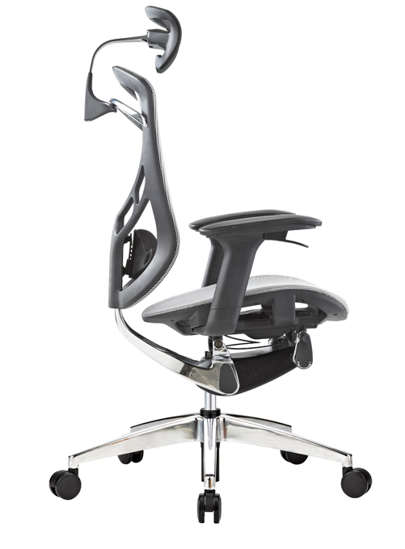
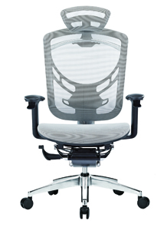
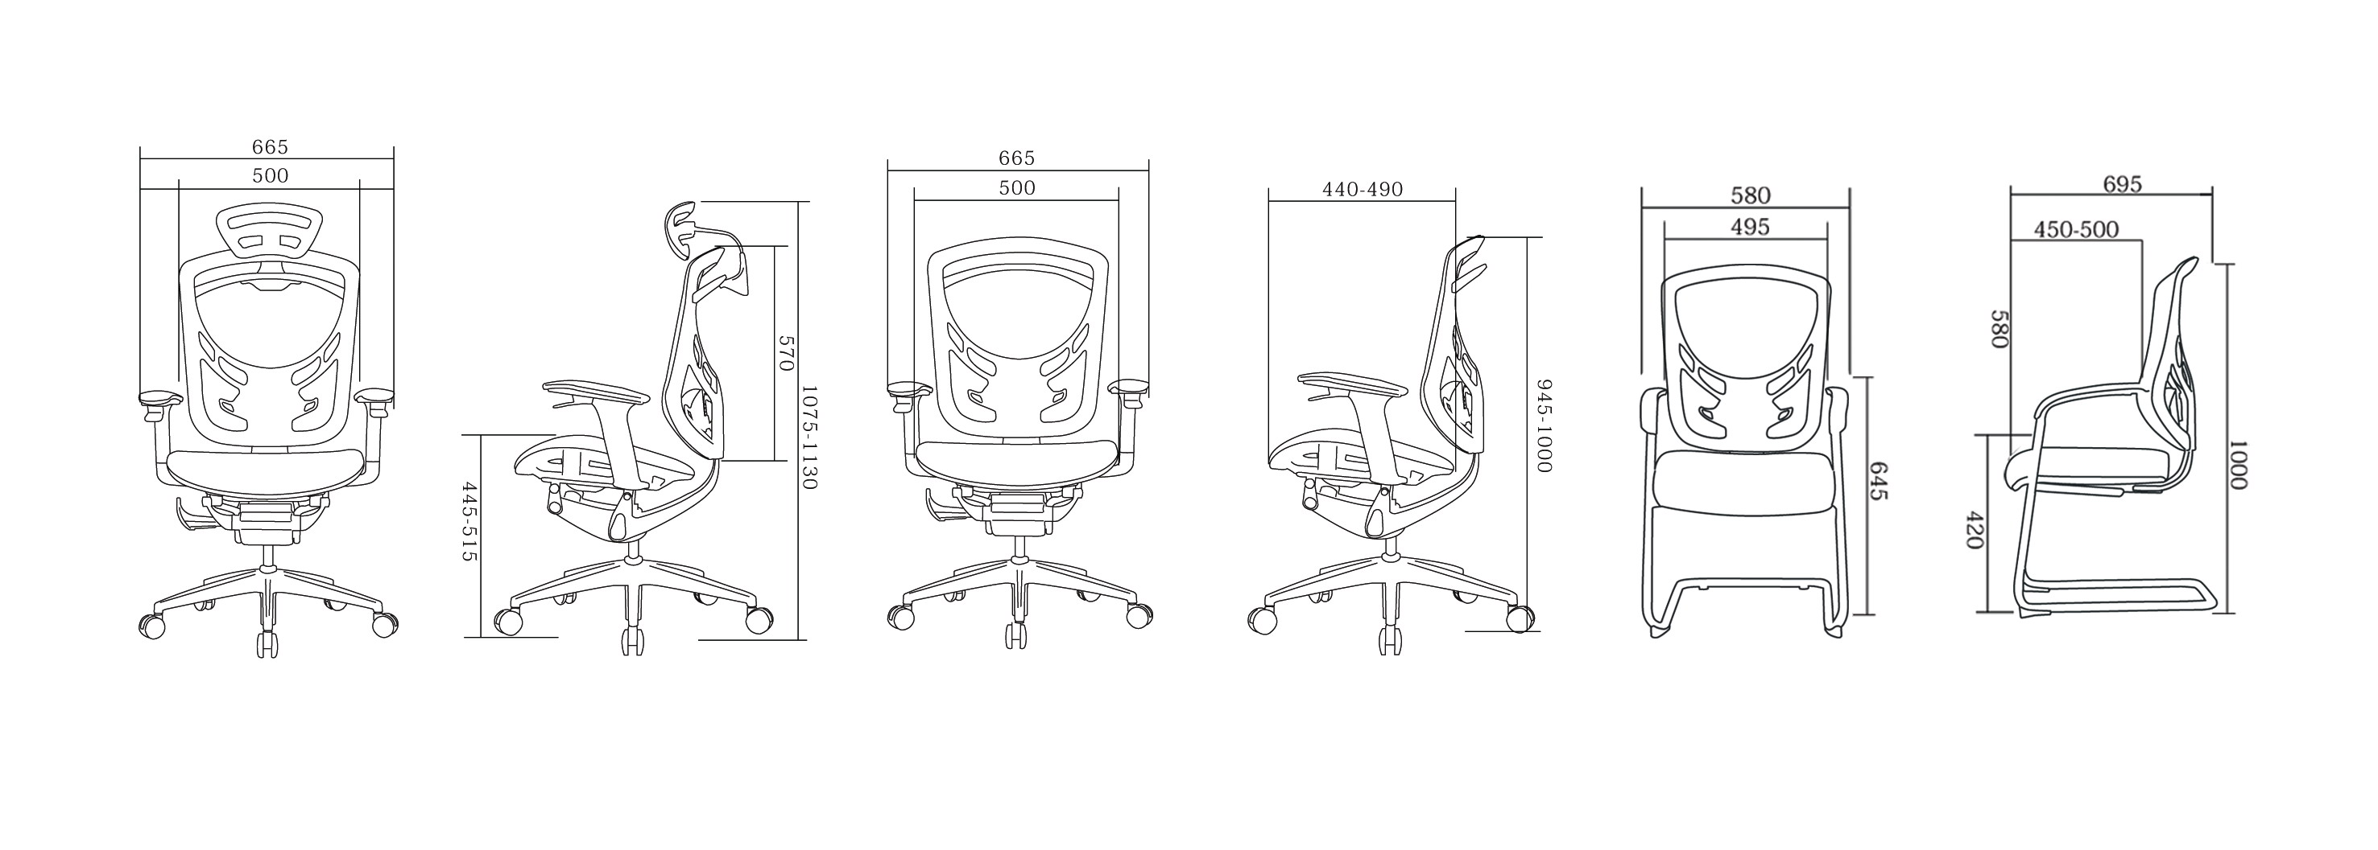
SEATING – Office Chairs -SR 12 ( I-vino )

Slide 6
Office Chairs -SR 12 ( I-vino ) Products details
Seat Height Adjust
The seat height can be adjusted by the paddle shift under
the right side armrest .Holding the paddle shift, the body
weight will make the chair lower , releasing the paddle shift ,
the chair height will be locked at desired position. Holding the
paddle shift without weight on the seat will make it rise .
Seat Depth Adjustment
Pressing the button on the left side of the seat will activate the
seat depth adjustment . Sliding chair seat with body strength ,
release the button at proper position will lock the seat .
2. Backrest Tilt Adjustment
The paddle shift under the left armrest can adjust the back tilting .
lifting the paddle shift once and release with the body weight pressure
on the back will lock the backrest at a proper position . Lifting the
paddle shift again will unlock the backrest , and it can be waggled
freely again .
Backrest Height Adjustment
Pulling up the chair back will adjust its height higher , and the
chair back will go down to the original position when it arrives
the highest point.
Armrest Height and Angles Adjustment
Pulling up the armrest will adjust its height . When it arrived
the highest level , it will go down to the original position . The
arm pads also easily pivot .
Lumbar Support Adjustment
Sliding the lumbar support up and down can adjust its height.
Backrest Tilting Tension Adjustment
Pulling out the knob at the lower right side of the seat , turn it
deasil ,the inclining tension of the backrest will get higher , while
turn it widdershins , the tension get lower.
Headrest Adjustment
Pulling headrest vertically will change its height and angle.

Slide 7
SEATING – Office Chairs -SR 13

Slide 8
Office Chairs -SR 13 Products details
Seat Height Adjust
The seat height can be adjusted by the paddle shift under
the right side armrest .Holding the paddle shift, the body
weight will make the chair lower , releasing the paddle shift ,
the chair height will be locked at desired position. Holding the
paddle shift without weight on the seat will make it rise .
Seat Depth Adjustment
Pressing the button on the left side of the seat will activate the
seat depth adjustment . Sliding chair seat with body strength ,
release the button at proper position will lock the seat .
2. Backrest Tilt Adjustment
The paddle shift under the left armrest can adjust the back tilting .
lifting the paddle shift once and release with the body weight pressure
on the back will lock the backrest at a proper position . Lifting the
paddle shift again will unlock the backrest , and it can be waggled
freely again .
Backrest Height Adjustment
Pulling up the chair back will adjust its height higher , and the
chair back will go down to the original position when it arrives
the highest point.
7. Headrest Adjustment
Pulling headrest vertically will change its height and angle.
Armrest Height and Angles Adjustment
Pulling up the armrest will adjust its height . When it arrived
the highest level , it will go down to the original position . The
arm pads also easily pivot .
Backrest Tilting Tension Adjustment
Pulling out the knob at the lower right side of the seat , turn it
deasil ,the inclining tension of the backrest will get higher , while
turn it widdershins , the tension get lower.

Slide 13
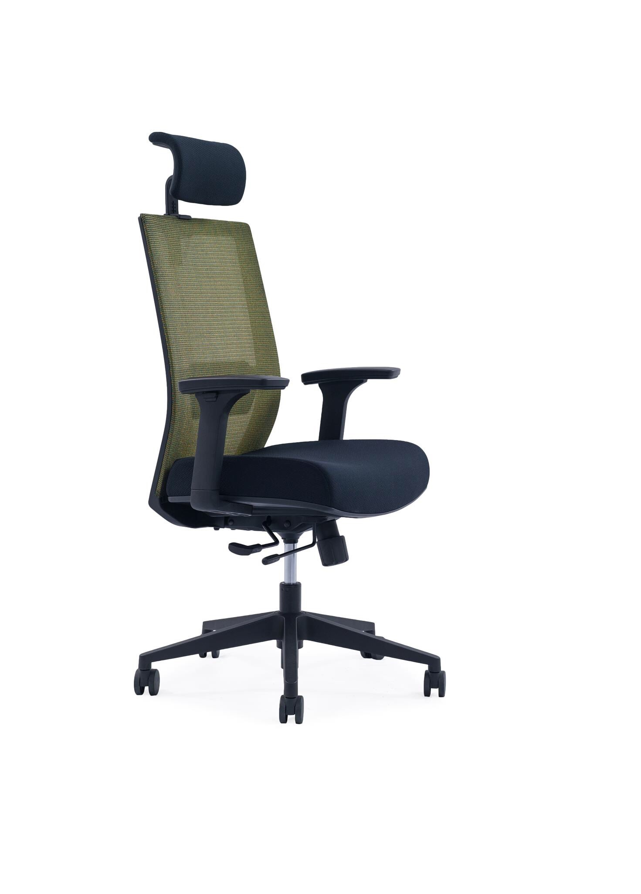
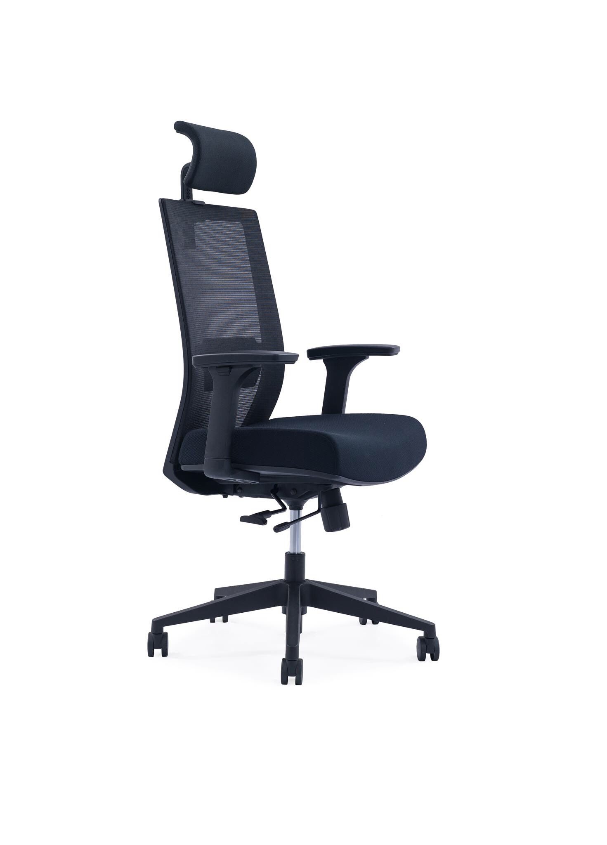
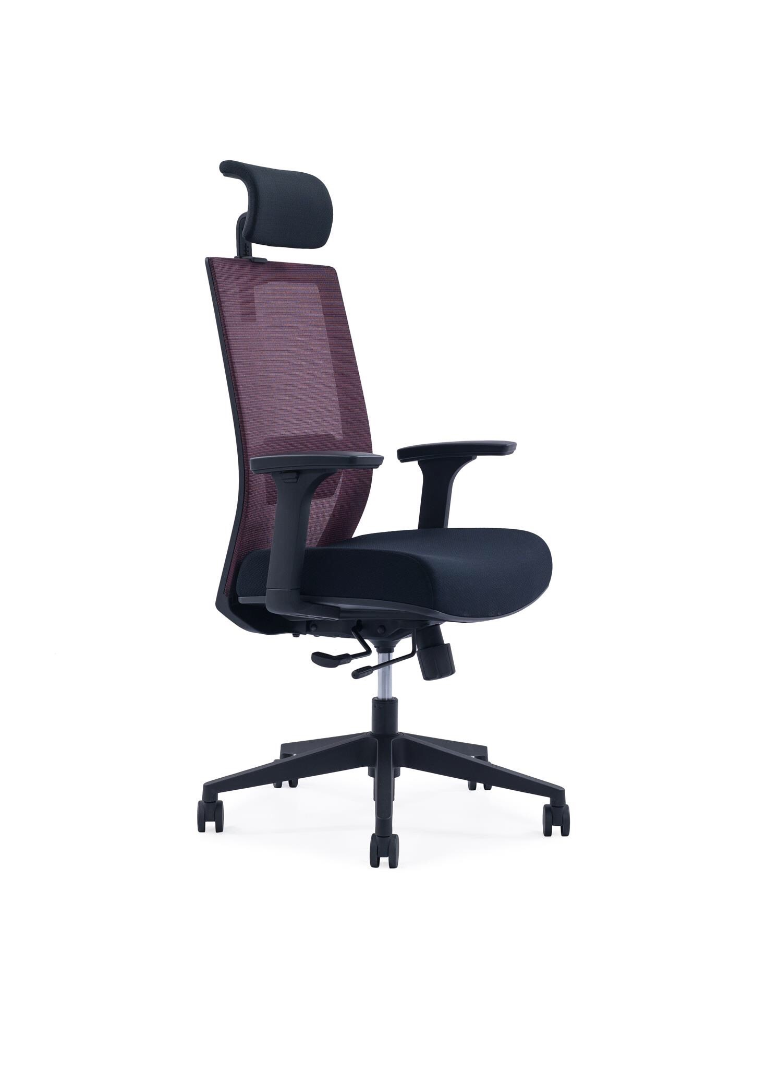
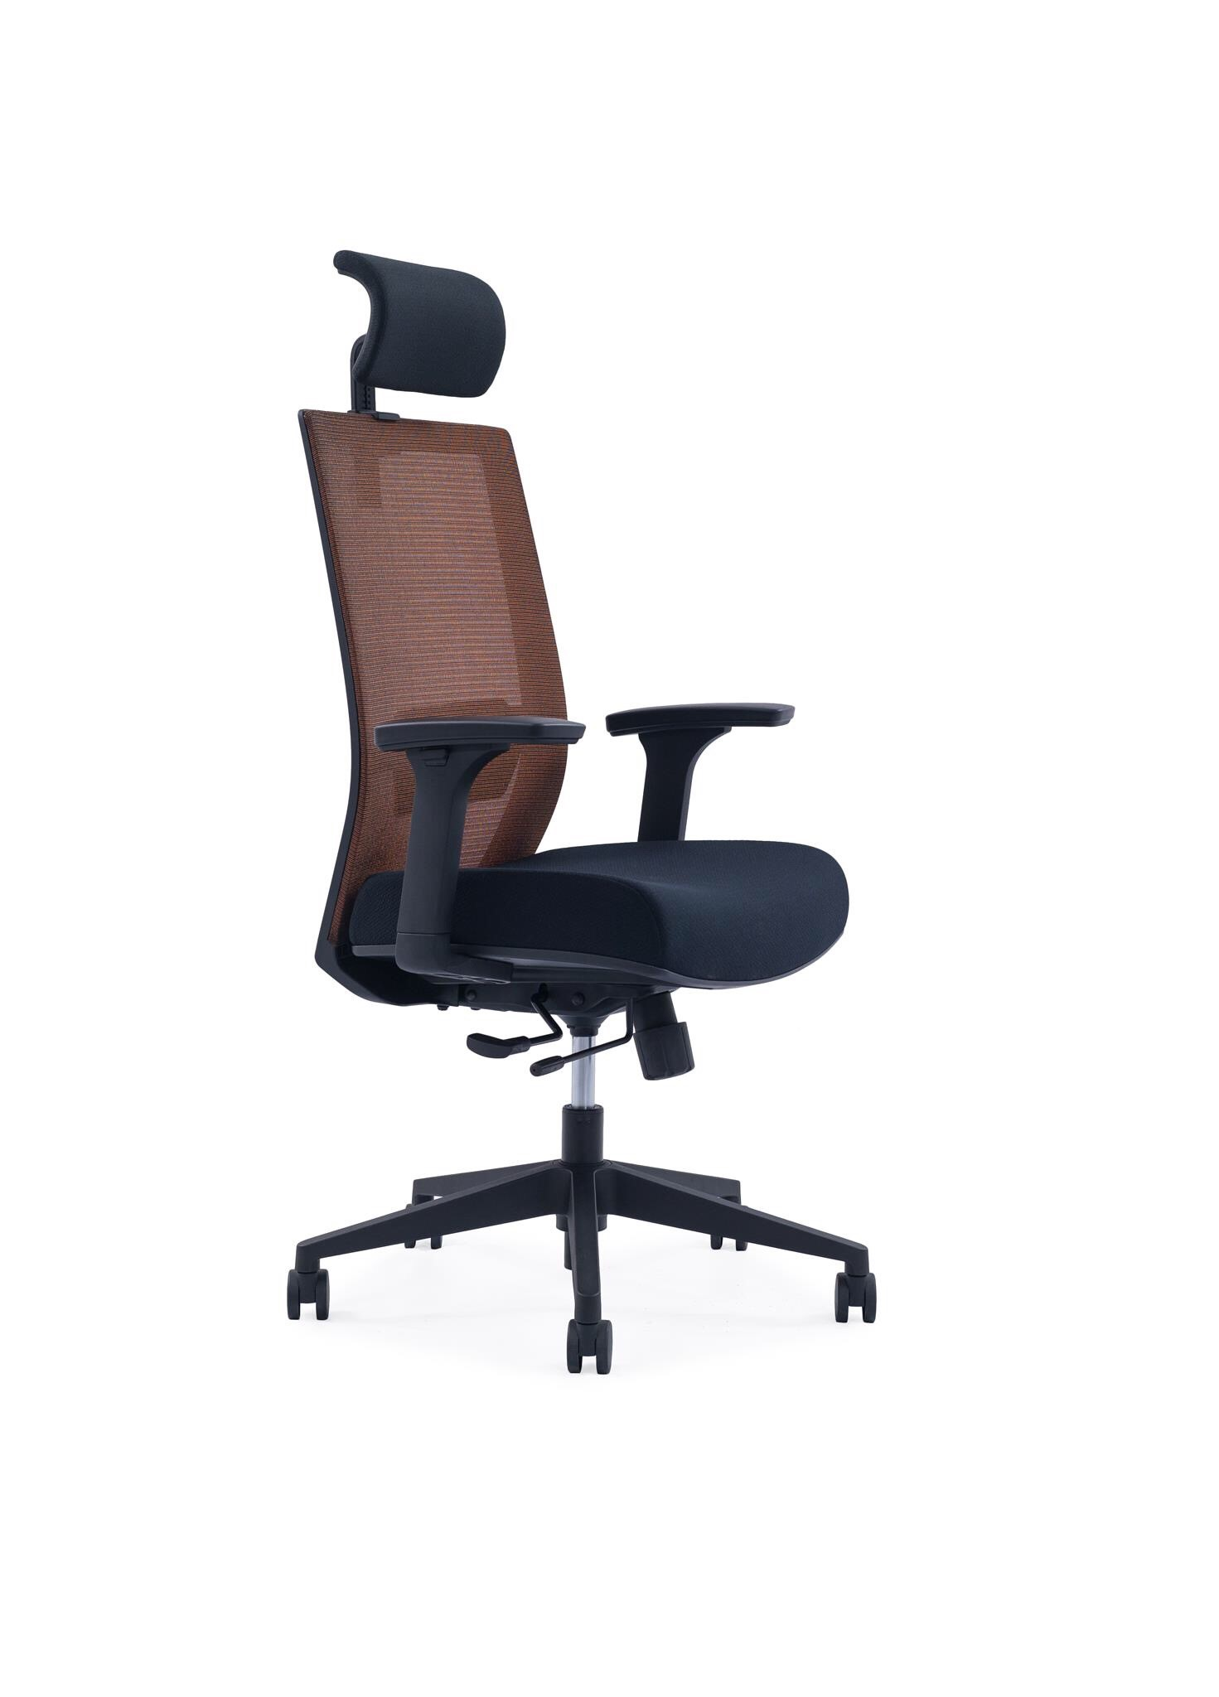
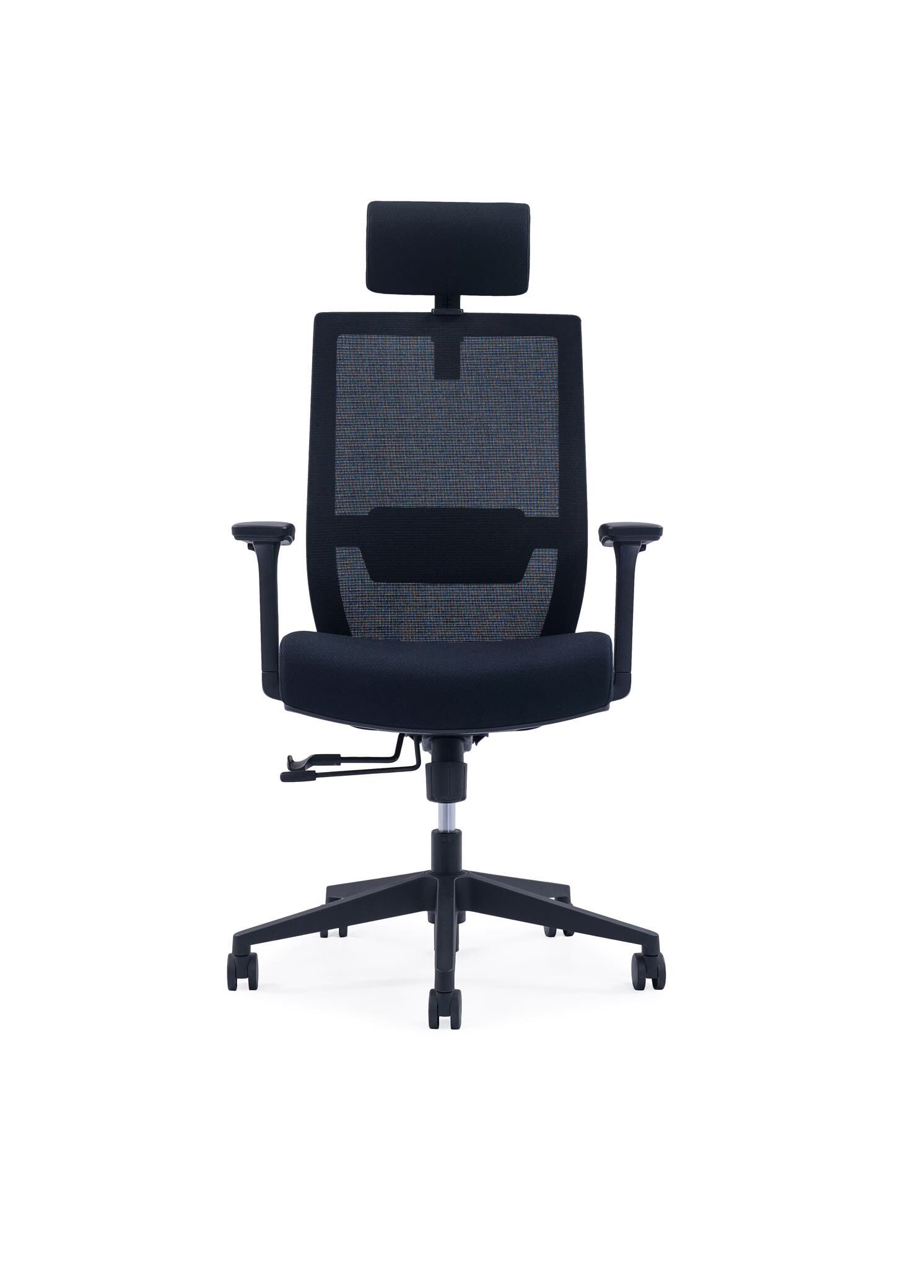
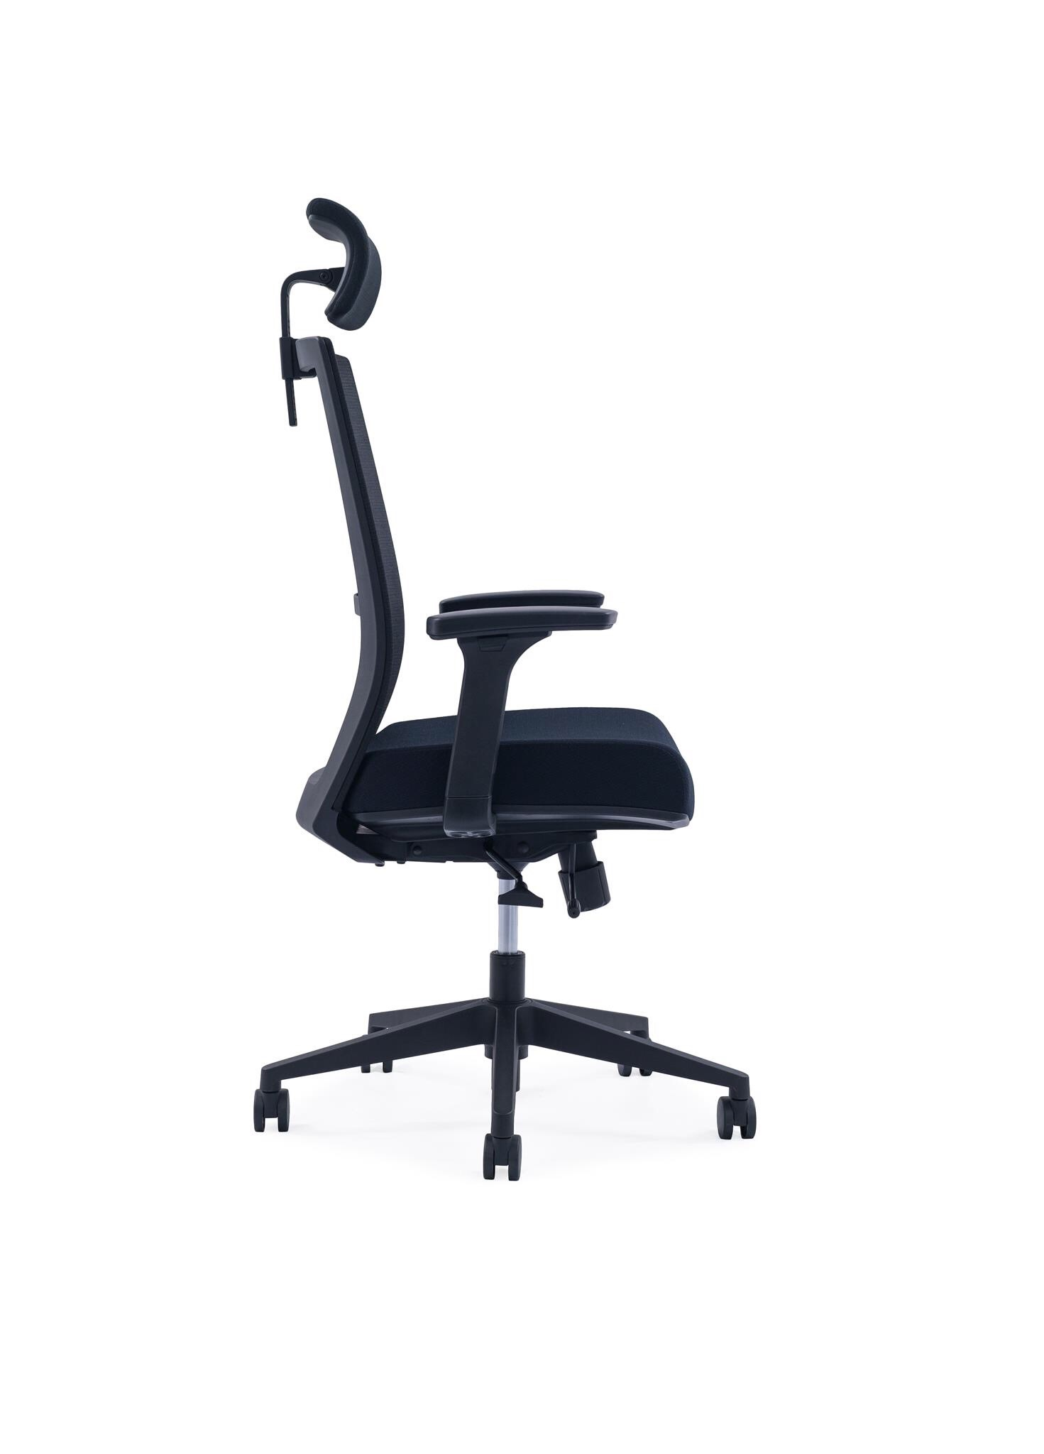
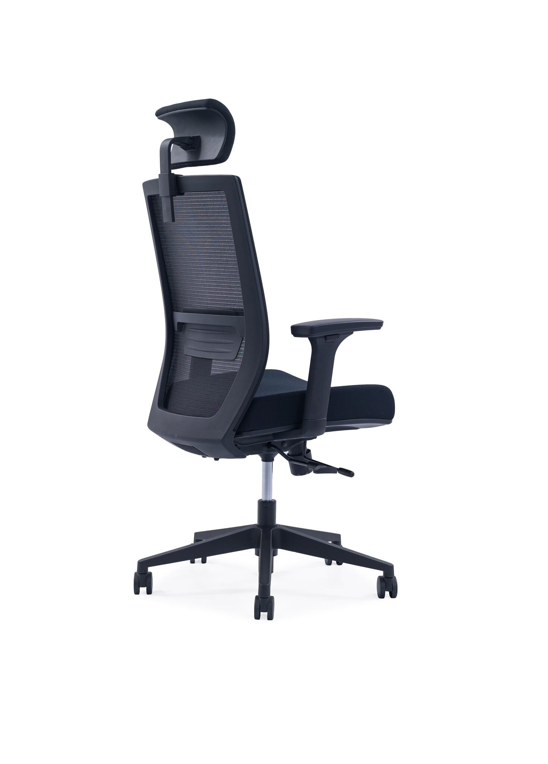
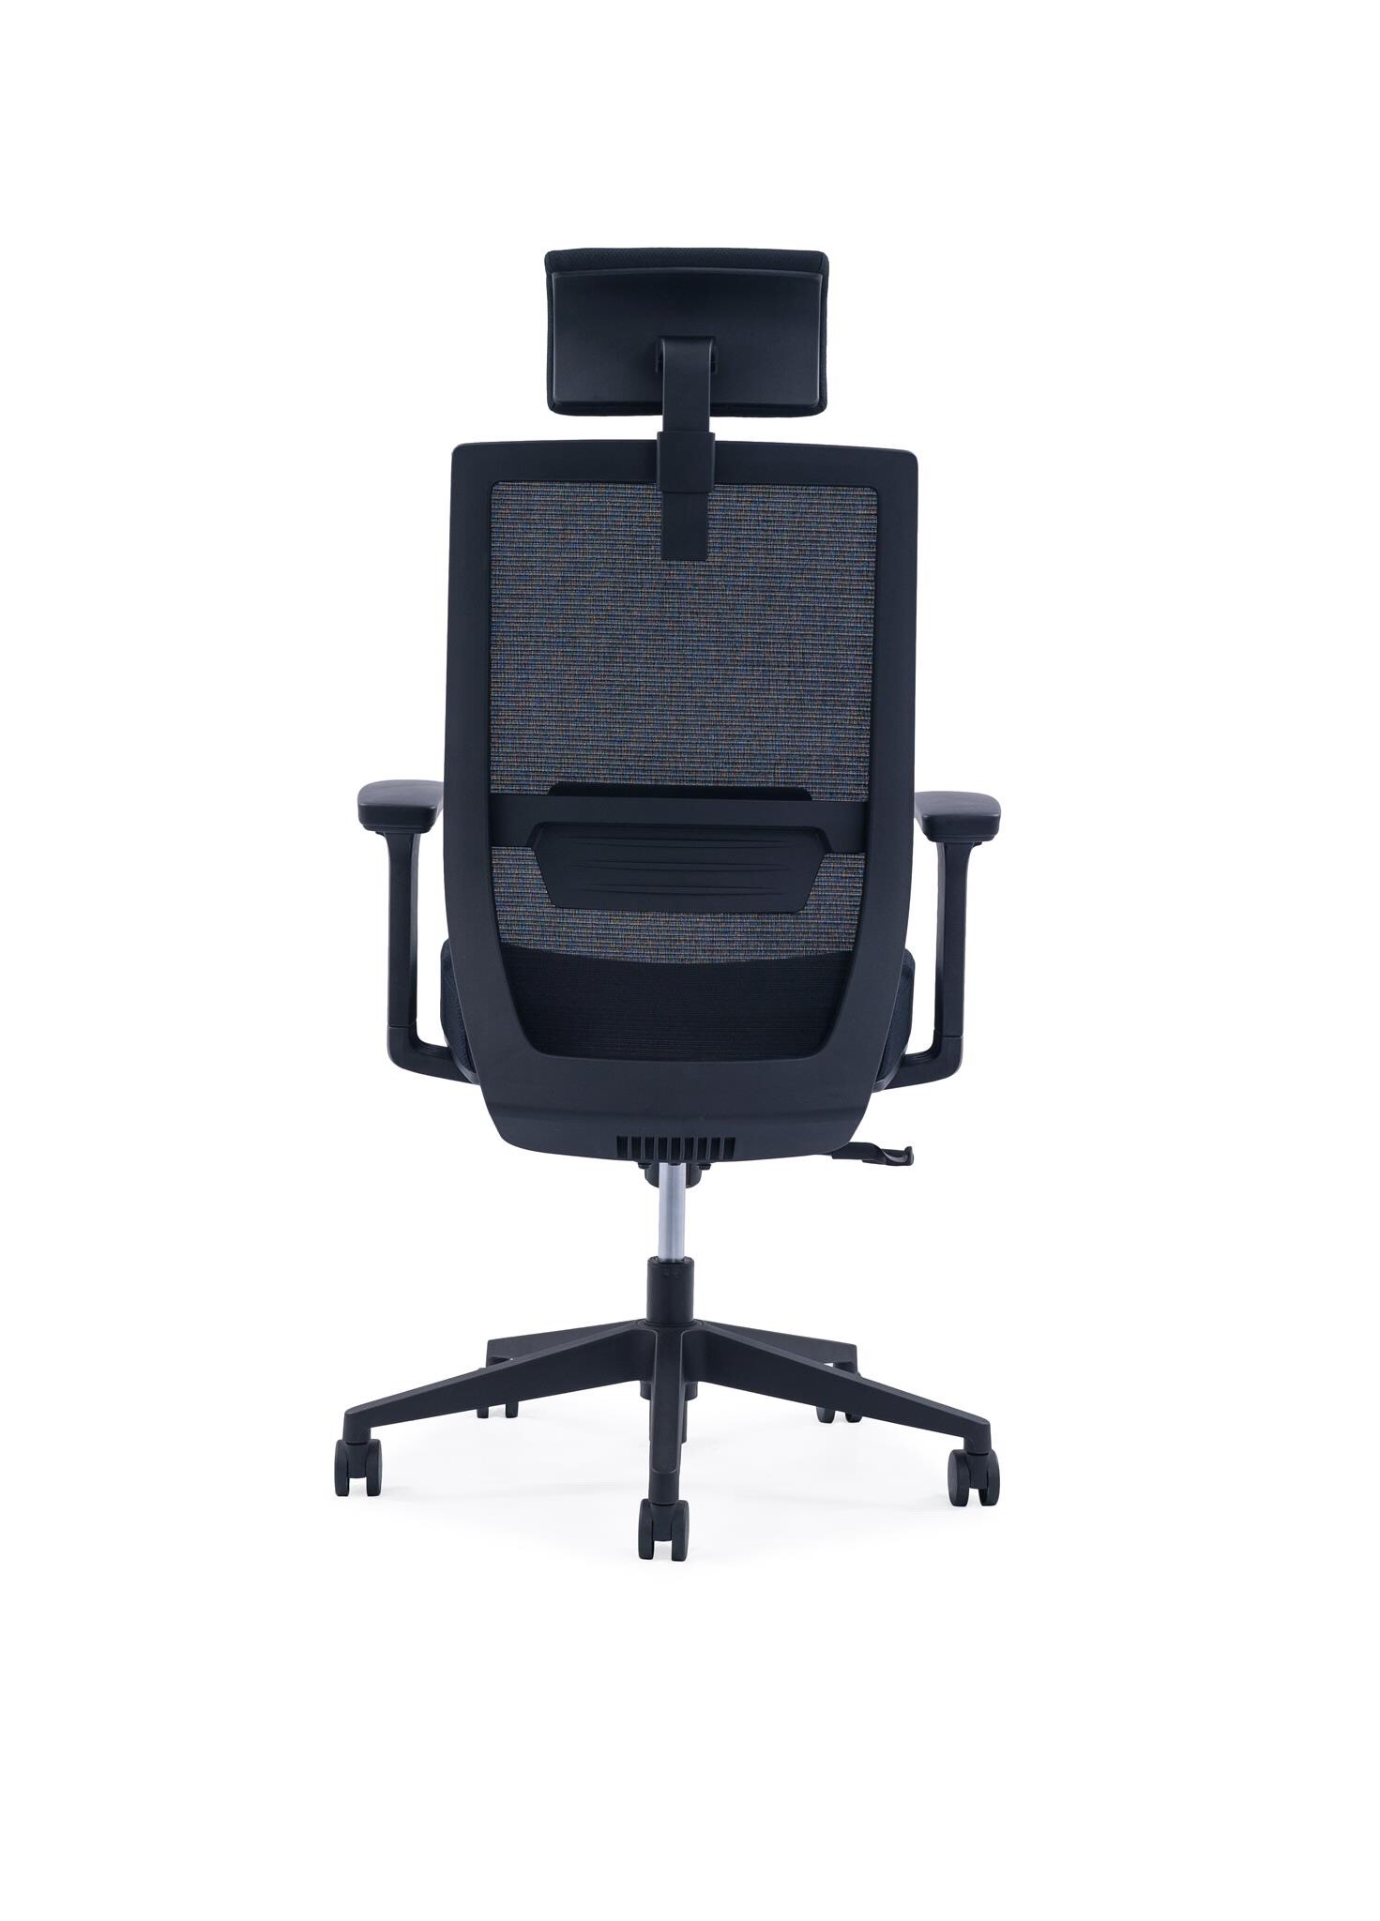
TD Highback Series
The clean and elegant color and structure coruscate the
Unique expressive force and permanent life .
Product Features
Headrest Adjust
Backrest Tension Adjust
2D Armrest Adjust
Seat Depth Adjust
75mm Molded Cushion
Back Lumbar Support Adjust
3 Position Lock
Seat Height Adjust
Sleek 5 Pedestal Nylon Base or Alloy Base*
Korea Wintex Mesh
Korea Samhongsa Gas lift

Slide 14
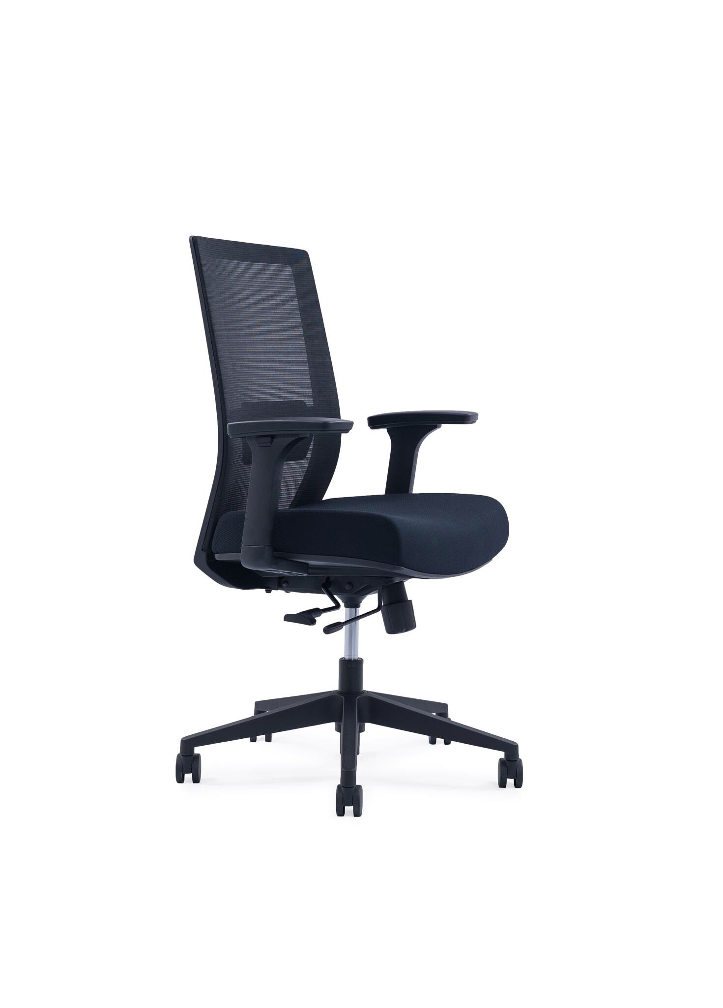
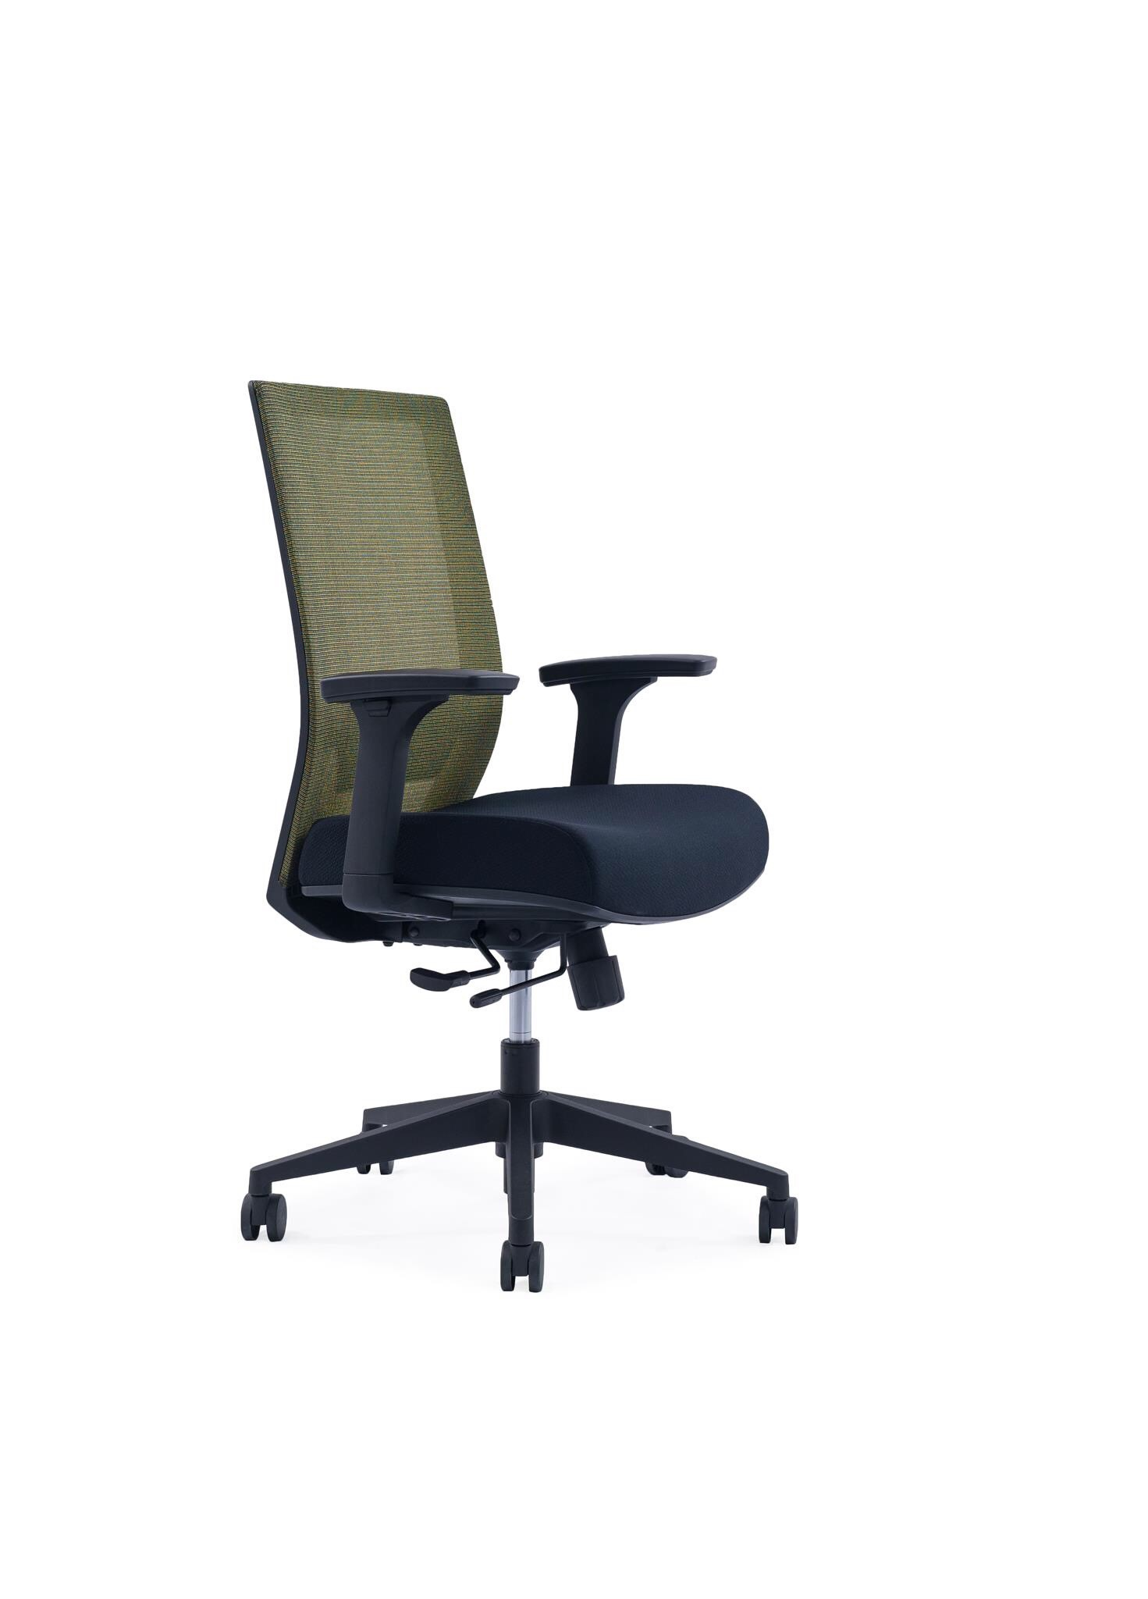
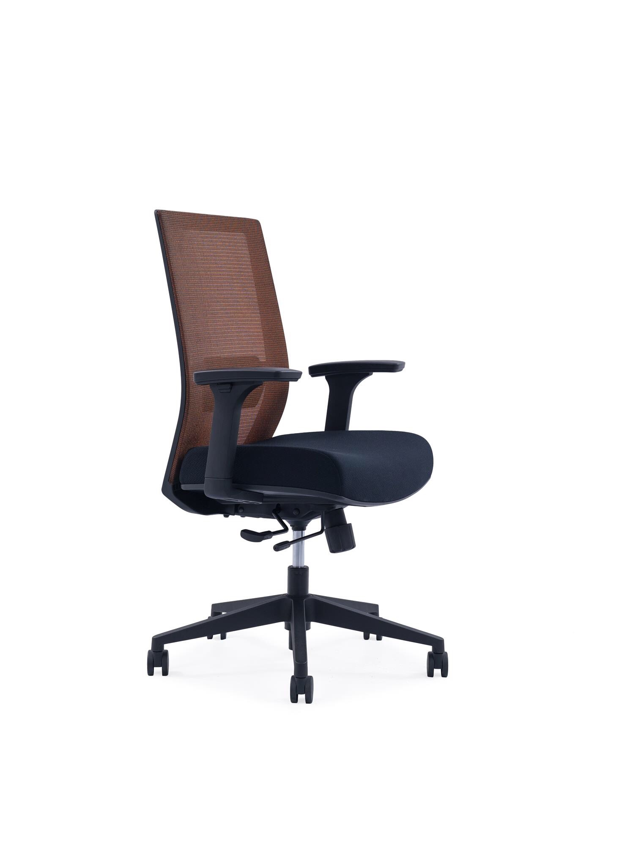
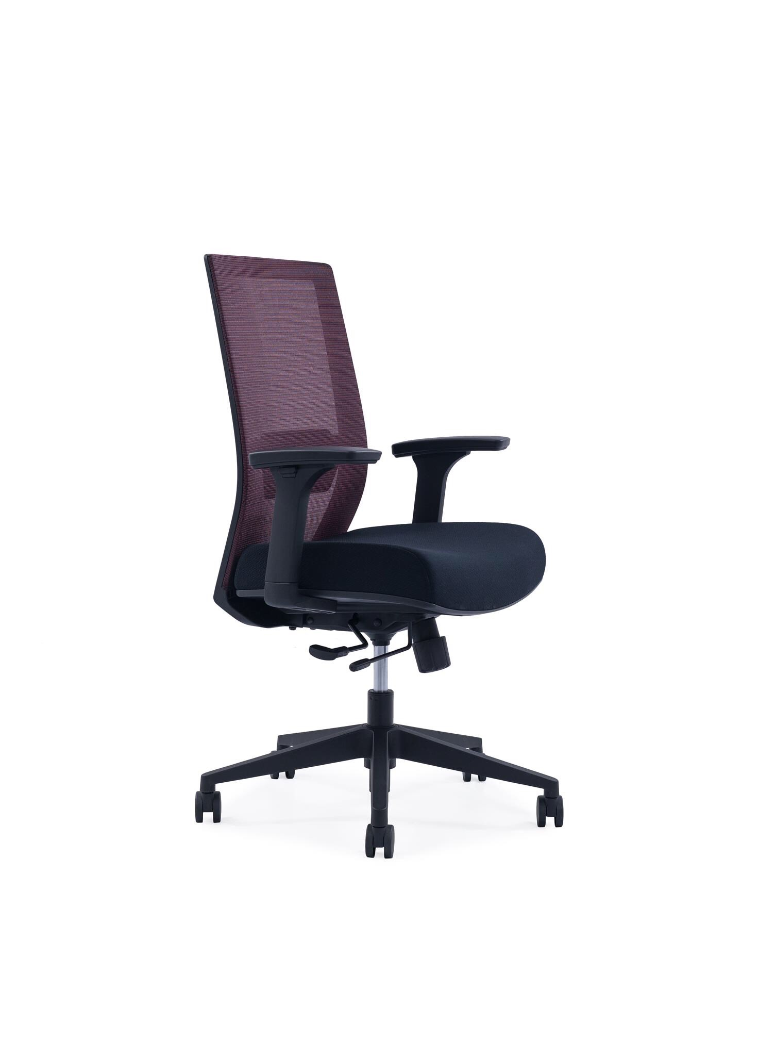
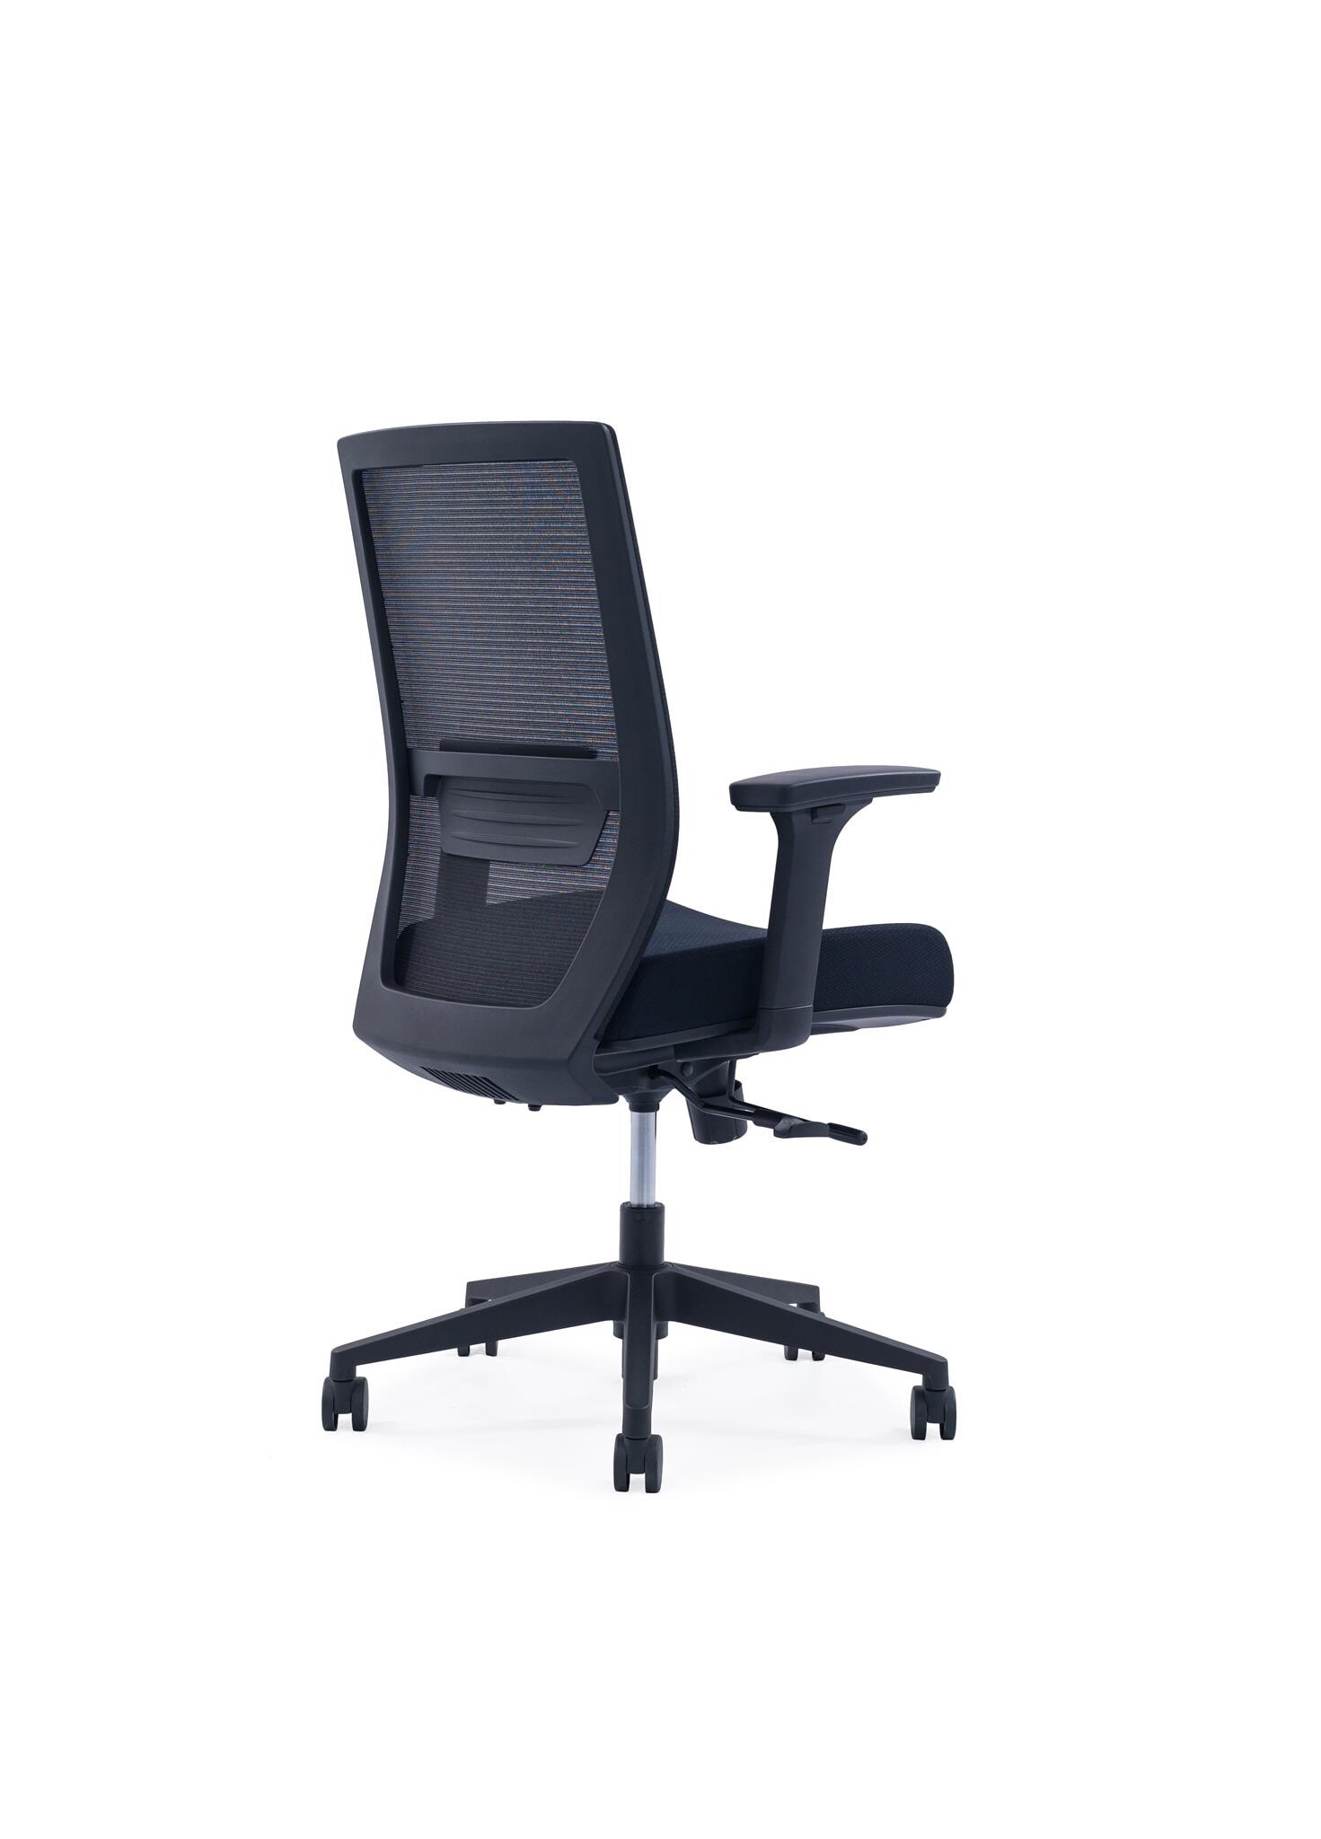
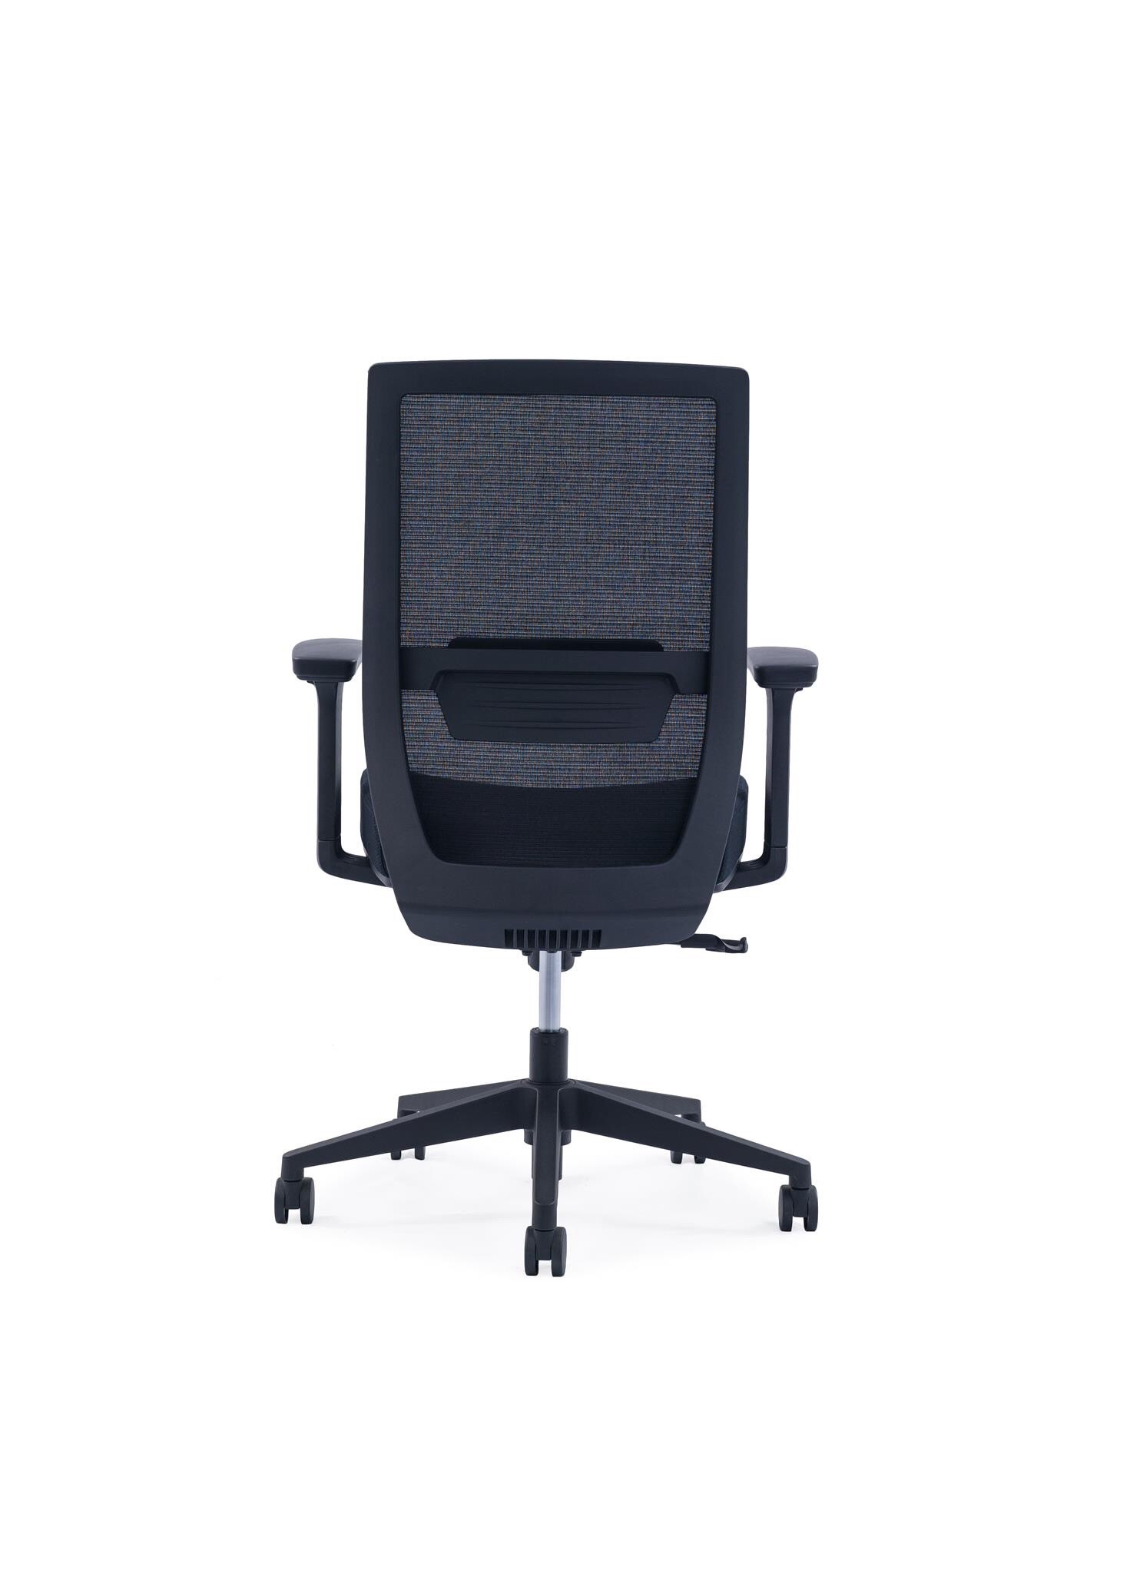
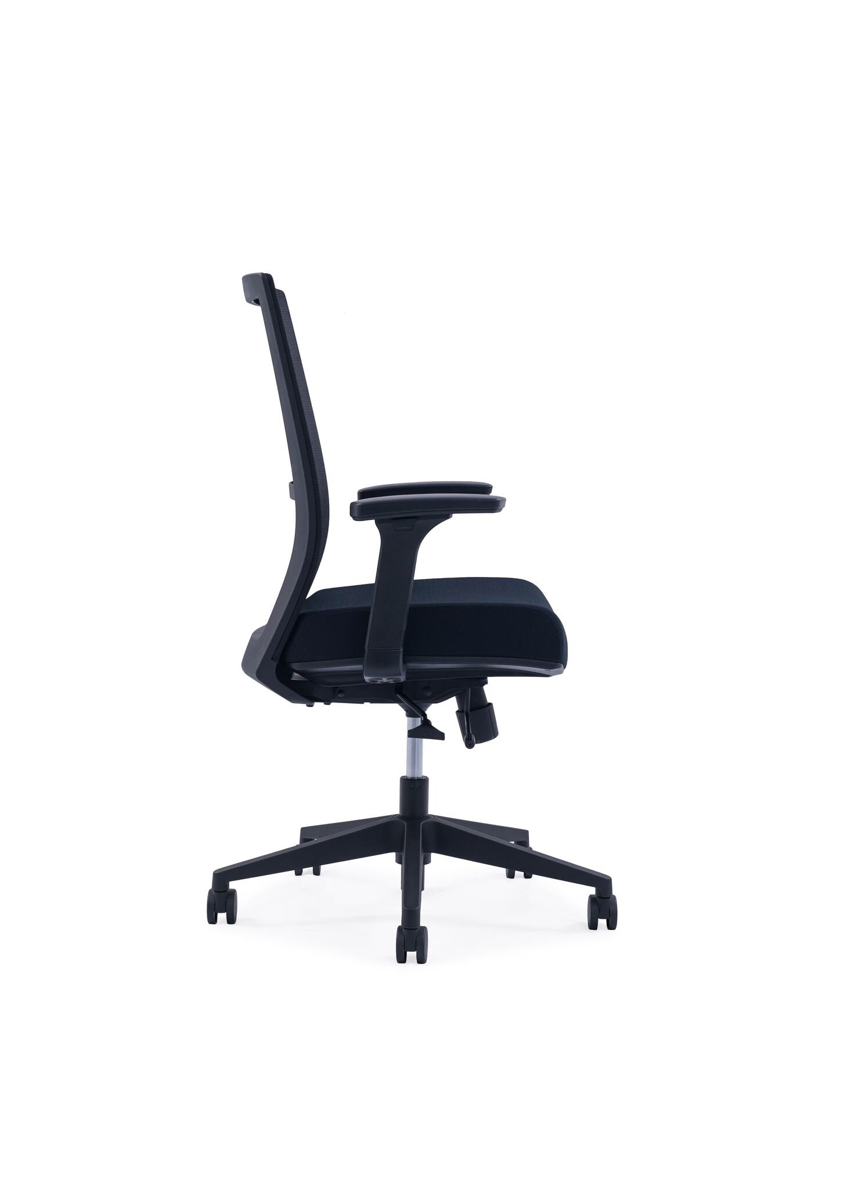
TD Midback Series
Product Features
Backrest Tension Adjust
2D Armrest Adjust
Seat Depth Adjust
75mm Molded Cushion
Back Lumbar Support Adjust
3 Position Lock
Seat Height Adjust
Sleek 5 Pedestal Nylon Base or Alloy Base*
Korea Wintex Mesh
Korea Samhongsa Gas lift

Slide 15
Desking System

